Slide 1
Sherwood Forest Community Club
Annual Meeting 2020
10-22-2020

Slide 2
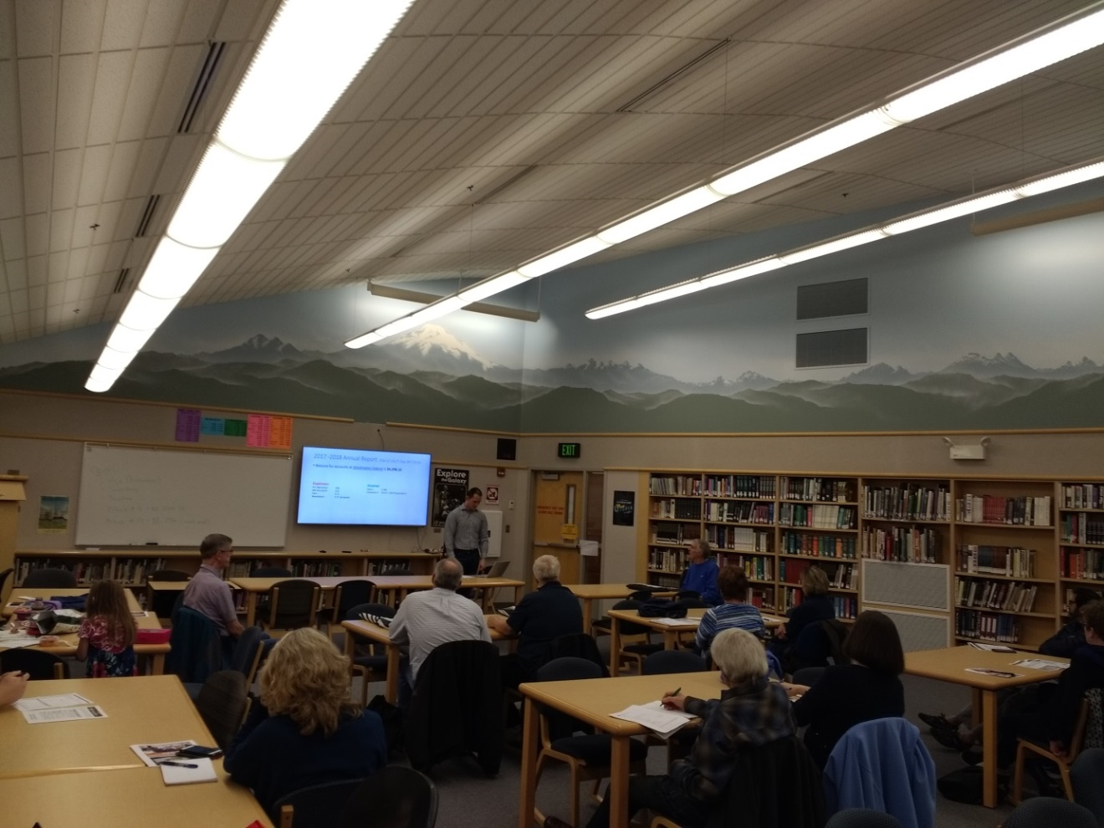
Agenda
7:00PM: Start
  Overview of Sherwood Forest
  Overview of Sherwood Forest Community Club (SFCC)
  Key committee reports
    Treasurer
    Land Use
      BTC Update
      Covenant
  City of Bellevue programs
  Board Election
  Discussion/Comments/Q&A
8:30PM: End

Slide 3
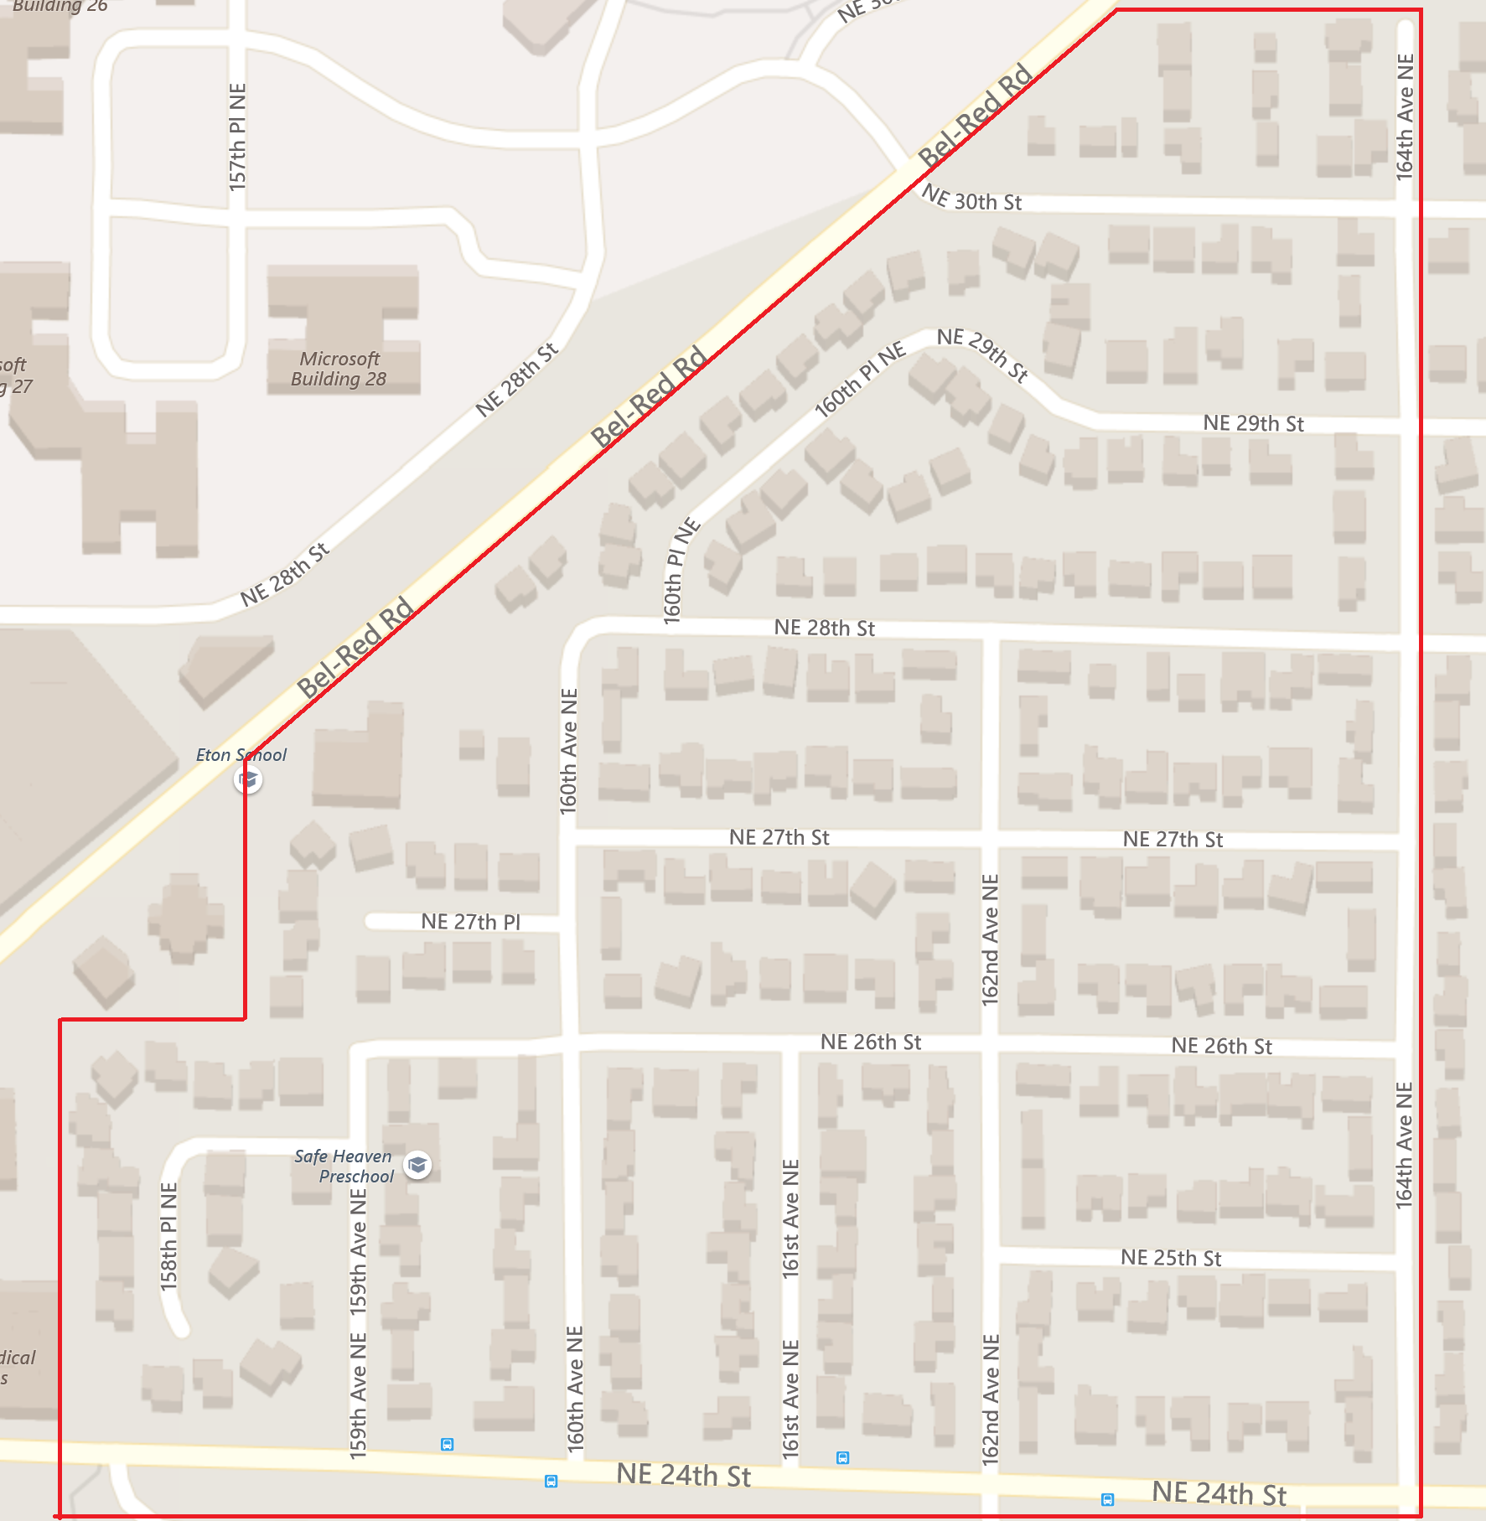
Sherwood Forest:
Our Community

Slide 4
SFCC Organization Structures
Board
President
Vice President
Secretary
Treasurer
Trustee
Trustee
Trustee
Committee Chairs
Land Use
Traffic
Communications
Neighborhood Enhancement
Block Watch
Emergency Preparedness
(18) Block
Representatives

Slide 5
2020 SFCC Board
President – Lee Sargent
Vice President – Patrick Tousignant
Secretary – Anne Drebin
Treasurer – John Haro
Trustees
Honorary
Ken Schiring
Janet Castaneda
Kurt Howeler
Emmanuel Solis

Slide 6
SFCC Organization Roles
Board
  Representative body for Sherwood Forest
  Meets monthly (on the 3rd Thursday normally)
    (Try to) Follows Robert’s Rules For Small Non-Profits
    Make all meeting notes available to members (online)
Committees
  Led by Committee Chair
  Specific focus area (e.g. Traffic)
  Provides update at Board monthly meeting
Block Representatives (aka Block Captains)
  Liaison between block residents and Board
  Delivers newsletters and other SFCC material to residents on the block
  [ONGOING] Engage the Block Reps in the monthly board meetings so they share insights on their blocks and learn what is going on in the SFCC area.

Slide 7
SFCC Committees
(we currently have no committees)
Block Watch Committee
Develop and implement, block-by-block, the City of Bellevue Block Watch program to promote residential awareness, safety, and security.
Involve Block Representatives and other residents in this effort of community safety.
Communication Committee
Develop and maintain an electronic communication system. Help with publication of Quarterly SFCC newsletters and any other community material.
Block Representatives will distribute printed material such as SFCC newsletters etc to residents.
Emergency Preparedness Committee
Develop and implement a block-by-block preparedness program to address impacts from severe storms, earthquakes, and other disasters.
Involve Block Representatives to educate residents on the program.
Land Use Committee
Monitor Bellevue and Redmond land use development proposals affecting the Sherwood Forest neighborhood. Have contact with City of Bellevue officials on Land Use. Be involved with City of Bellevue Land Use events, send summary of event back to SFCC Board.
Neighborhood Enhancement Committee
Monitor the Bellevue Neighborhood Enhancement program, including announcements and proposals for northeast Bellevue from City of Bellevue. Solicit feedback from residents, via Block Representatives, and other means such as social media, email etc., on enhancements to the neighborhood.
Traffic & Transportation Committee
Monitor and report to the SFCC Board of Directors regarding traffic flow patterns and speeds throughout the SFCC neighborhood. Monitor Bellevue and Redmond transportation plans, proposals, and projects with the potential to impact the Sherwood Forest Neighborhood

Slide 8
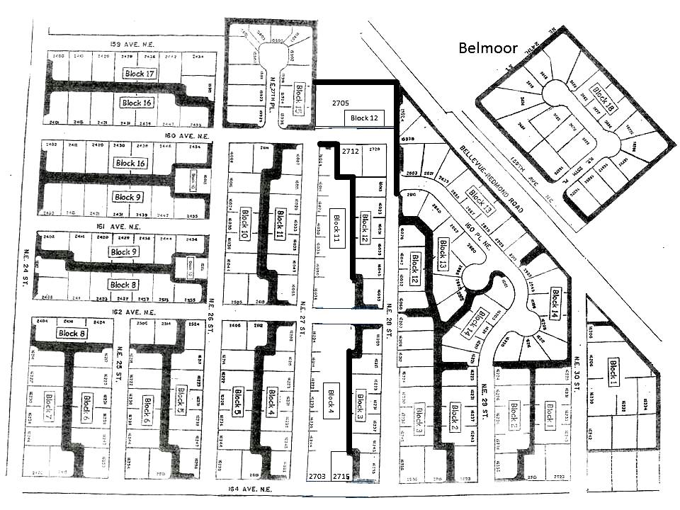
Sherwood Forest Community Blocks
Block # 1 NE 30th to 164th Kurt Howeler
2 NE 29th St (east end) Sam Osheroff
3 NE 28th St (east end) Ken Schiring
4 NE 27th St (east end) Charlie M. / Sylvia F.
5 NE 26th St (east end) Diane Parry
6 NE 25th St Samir Chudgar
7 NE 24th St (east end) Lee Sargent
8 162nd Ave NE (south end) Dan Crevensten
9 161st Ave NE John Haro
10 NE 26th St (west end) Grant Gilkinson
11 NE 27th St (west end) Allison Goodman
12 NE 28th St (west end) Nate Kessler Kessler
13 160th Pl NE (west Peachtree) Hank Sung
14 NE 29th (west end) Vacant (Sam O.)
15 NE 27th Pl (Sherwood Gardens) Regi John
16 160th Ave NE (south end) Karen Campbell
17 159th Ave NE Gary Dubois
18 Belmore Ying Ping

Slide 9
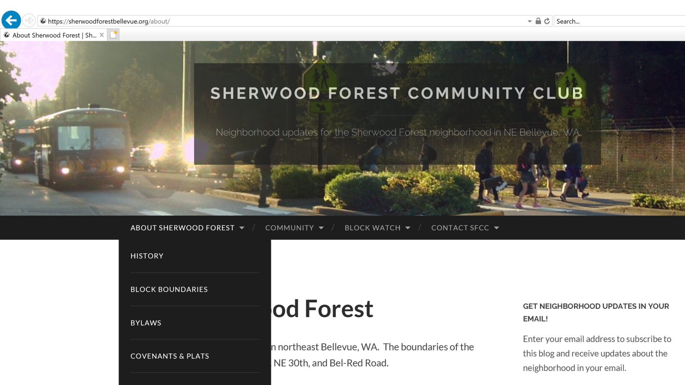
SFCC Website
http://sherwoodforestbellevue.org

Slide 10
Treasurer’s Report
John Haro

Slide 11
Sherwood Forest Community Club
TREASURER'S ANNUAL REPORT
October 1, 2019 - September 30, 2020
BECU Balances as of 9/30/2020
 | Checking Account Balance | $706.51
 | Savings Account Balance | $3,820.24
 | TOTAL | $4,526.75

Slide 12
Sherwood Forest Community Club
TREASURER'S ANNUAL REPORT
October 1, 2019 - September 30, 2020
Date | Description | Checking | Savings | Balance
9/30/2019 | Starting Balance | $ 572.57 | $3,817.94 | $ 4,390.51
various | Dues | $ 540.00
various | Donations | $ 435.00
various | Interest |  | $2.30
1/9/2020 | Bellevue School Dist (rent) | ($ 88.75)
1/17/2020 | Patrick Tousignant (covenant copying fees) | ($ 299.00)
1/17/2020 | John Haro(Reimburse for Sec. State 2020 invoice) | ($ 10.00)
2/11/2020 | US Postal Service (Conf# Q0JPX-1ZD1V - Yearly rental of PO Box) | ($ 118.00)
2/29/2020 | Lee Sargent (SFCC 500 PostCards, 150BusCards, 4Signs) | ($ 245.46)
7/24/2020 | Emmanuel Solis (Newsletters Jul 2020) | ($ 63.37)
7/24/2020 | Patrick Tousignant (ZOOM Account for SFCC 1-yr Jul 2020) | ($ 16.48)
9/30/2020 | Ending Balance | $ 706.51 | $ 3,820.24 | $4,526.75

Slide 13
Trustees statement on financial records
We have examined the treasurer's accounts every monthly meeting as
well as the annual report and found them to be complete and correct.
Therefore we sign on the treasurer’s annual report.
- Janet Castaneda, Emmanuel Solis and Kurt Howeler.
SFCC Trustees

Slide 14
Block Dues & Donations
Contributors: 54
Dues Collected: $540.00
Donations Given: $435.00
Residences in Area: 250
Donated Newsletter Printing: Very Helpful
Donated Website Costs: Very Helpful

Slide 15

THANK YOU
FOR
YOUR SUPPORT!

Slide 16

Annual dues – Payment options
Annual dues will remain at $10 per household
Ways to pay your dues:
  Send a check/cash in the envelope sent with the spring newsletter (was later this year)
  Setup automatic bill payment
  through your checking account
    Your bank will send a check for you once a year. Set it and forget it!
    No additional cost for you
  Send to:
    Sherwood Forest Community Club
    P.O Box 7344, Bellevue, WA 98008
    Tel (425) 985 6618
Notes:
Participation little more that 1 in 3 houses (33%)
At the moment we don’t need to raise dues but we may need to seek legal advise and representation which is very expensive
We have a quote of around 9K for BTC and covenant support

Slide 17
Land Use

Slide 18
BTC
Nothing currently to report
Thanks to efforts aided Emmanuel & Janet talking directly to council members. The city council narrowly approved keeping 3 year major planning revision frequency!
No applications allowed while the Great Neighborhoods city planning changes are in progress (more on that later).
Last year city council adopted the resolution sponsored by SFCC (and other Northeast neighborhoods) to limit number of re-application for Comprehensive Plan Amendment
SFCC will continue to stay engaged

Slide 19

More development near Sherwood Forest
Overlake - Redmond
  www.redmond.gov/overlake
Seritage (Sears) - Redmond
  http://www.redmond.gov/cms/One.aspx?portalId=169&pageId=224202
New Microsoft Campus - Redmond
  https://news.microsoft.com/modern-campus/
Northup Way to Crossroads Trail Improvement Project (Summer 2020)
  https://transportation.bellevuewa.gov/projects/neighborhood-projects/northup-way-to-crossroads-trail

Slide 20
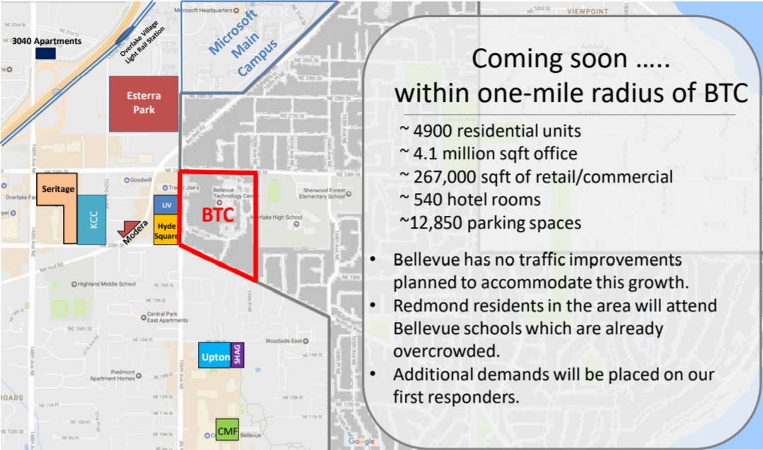
More development near Sherwood Forest

Slide 21
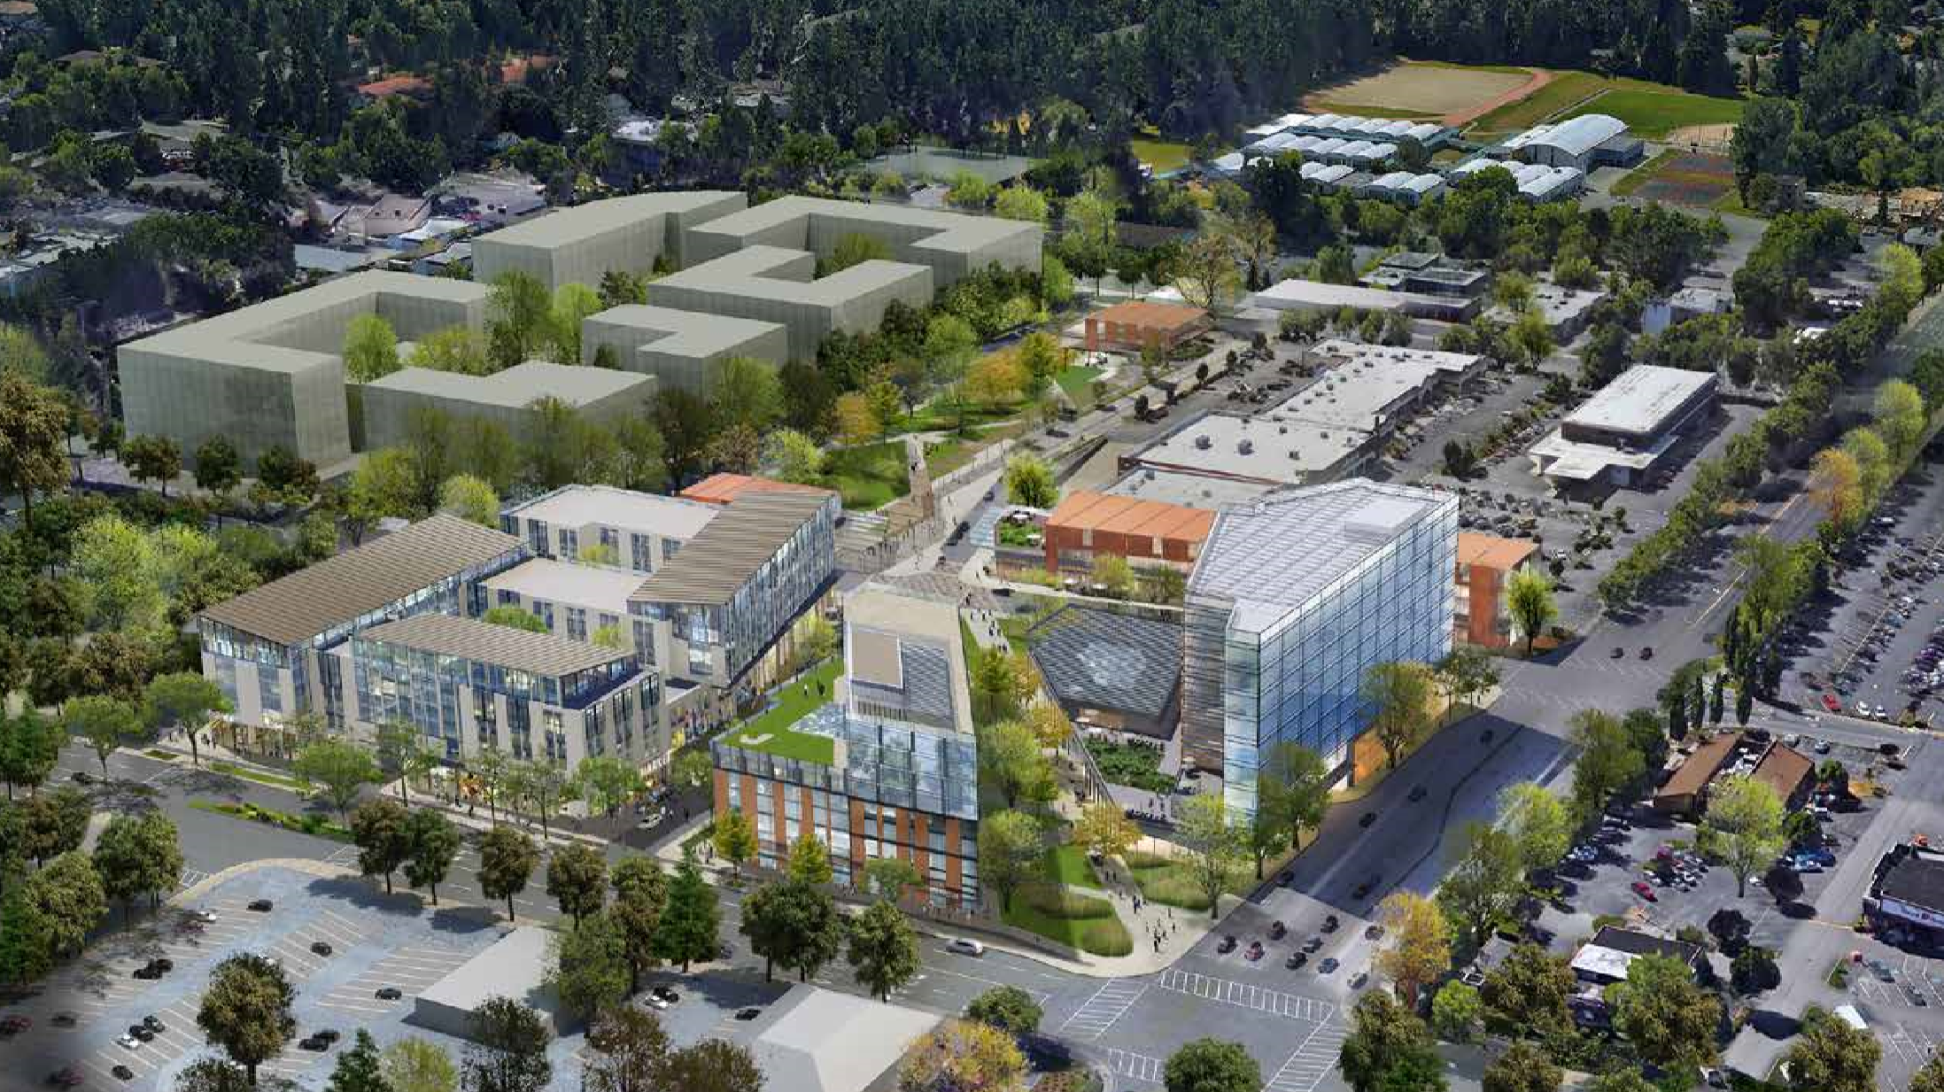
Seritage (Sears) - Redmond

Slide 22
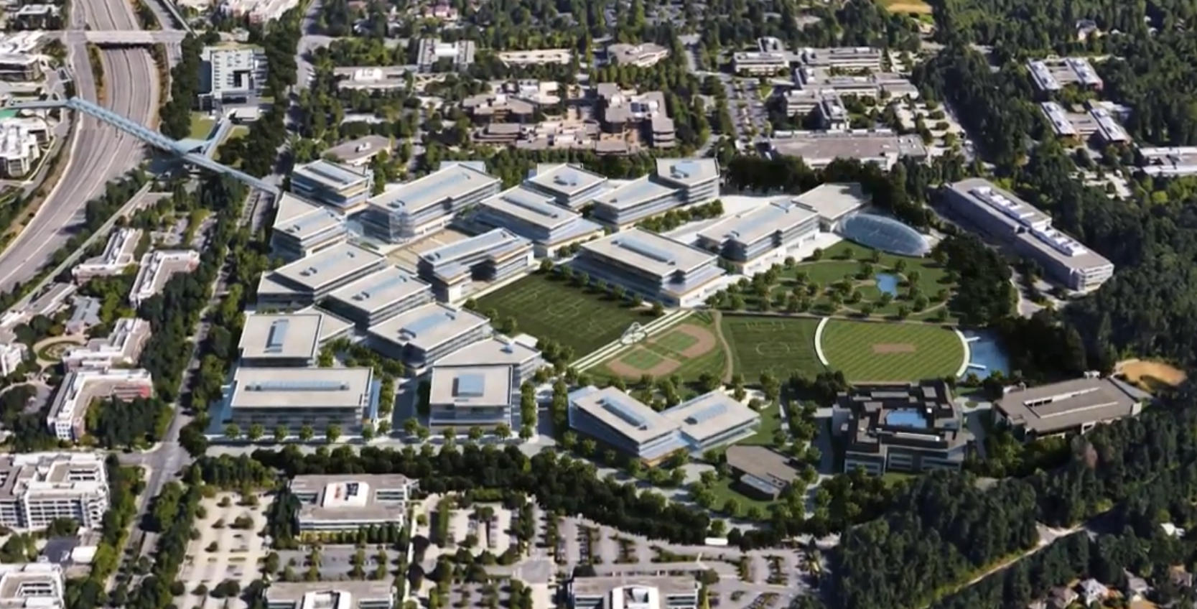
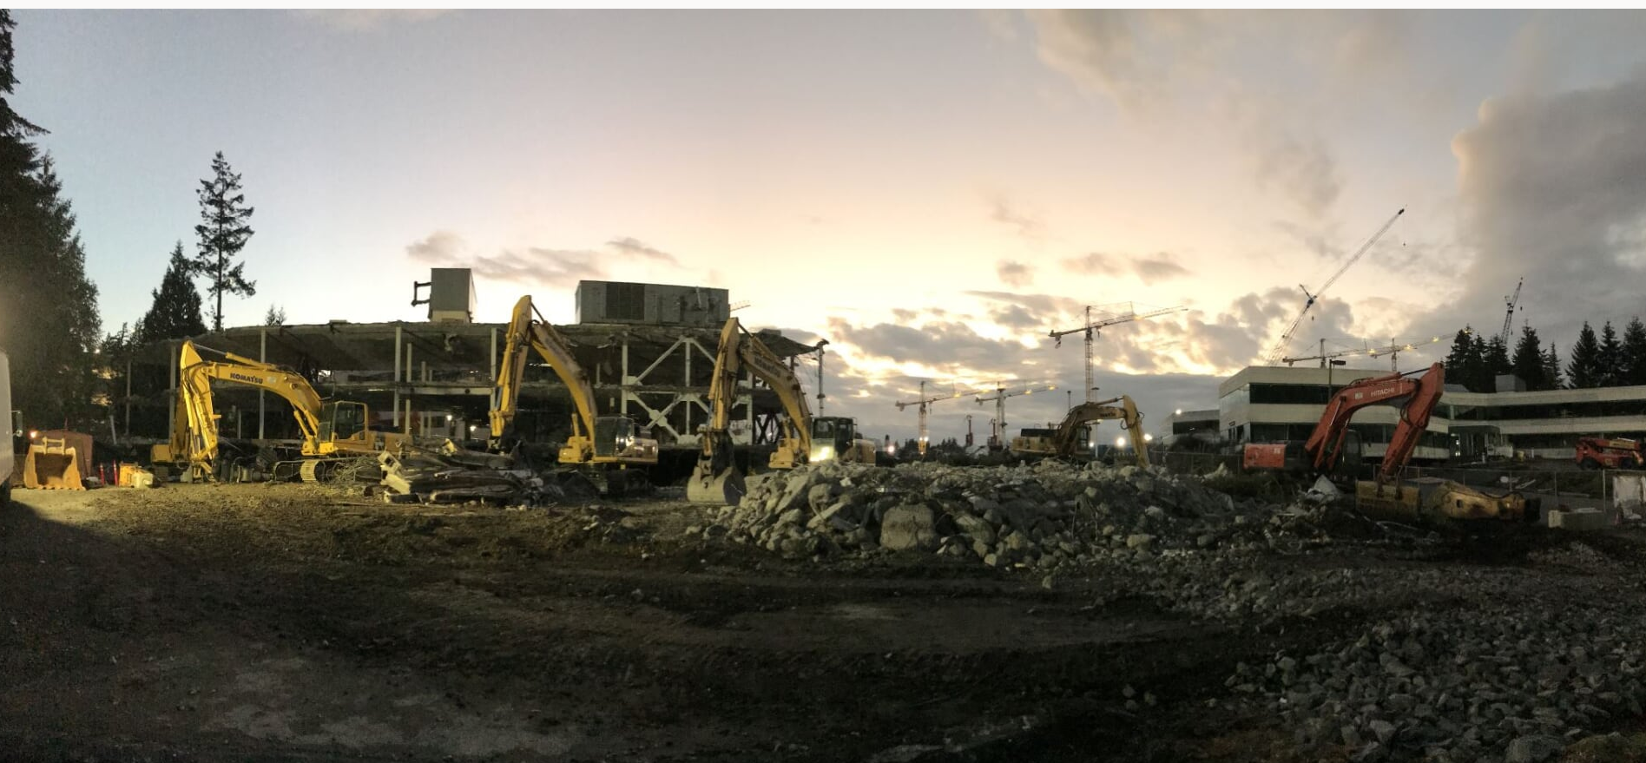
New Microsoft Campus - Redmond

Slide 23
SF Division Covenants and Two-story houses
Covenants from the 1950s and 60s limiting homes to single story.
All covenants are available at https://sherwoodforestbellevue.org/covenants
Covenants apply to a specific division or plat
An effort to remove the restriction for the Robison and Steward division succeeded last year.
  Owner used lawsuit to threaten neighbors until majority signed the amendment.

Slide 24
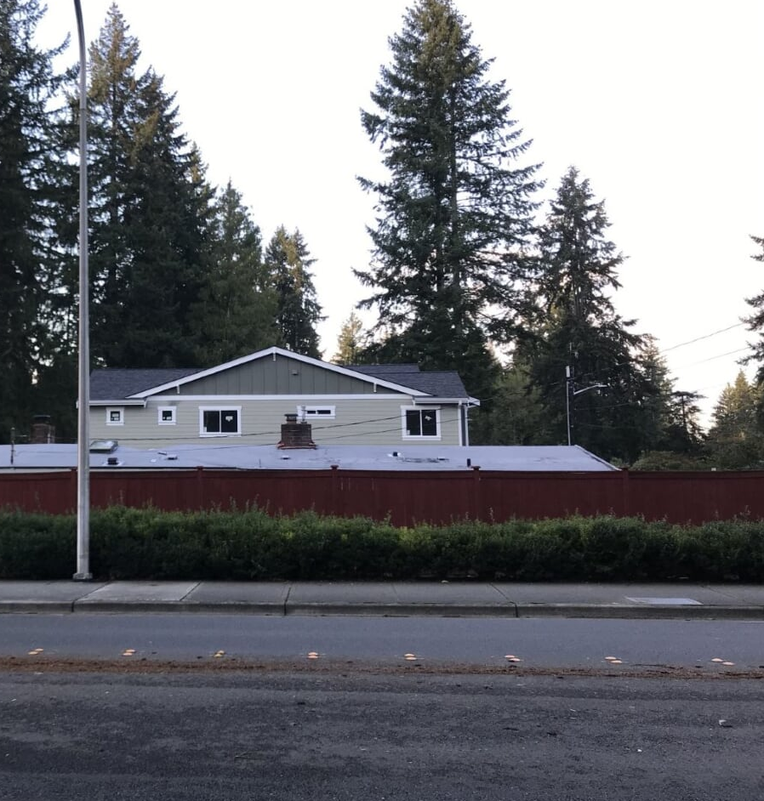
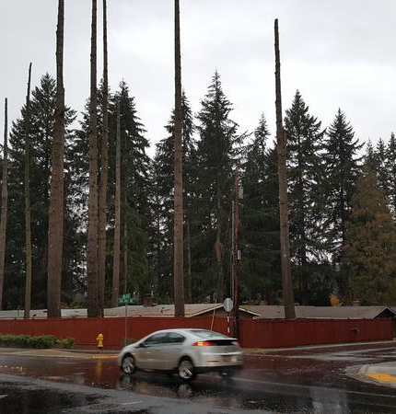
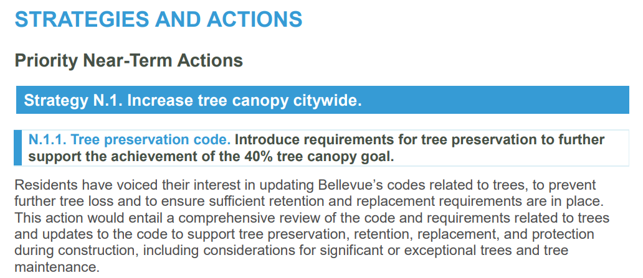
Tree removal in SF
Our neighborhood continues to lose evergreens
  2016 to 2020 – More than 30 trees lost ☹
SFCC continues to lobby CoB for a tree ordinance
  Does not appear to be happen soon but there is hope
  Hope to make it part of CoB’s Neighborhood Area Plan
  CoB’s Environmental Stewardship Plan (draft) includes this text:

Slide 25
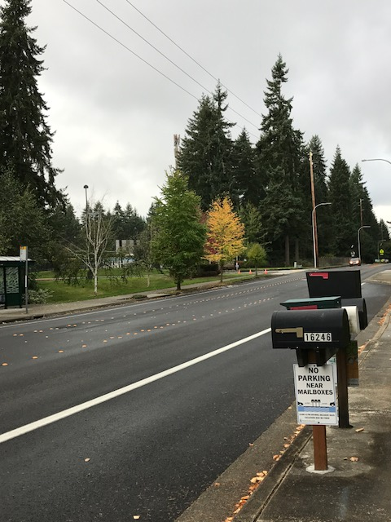
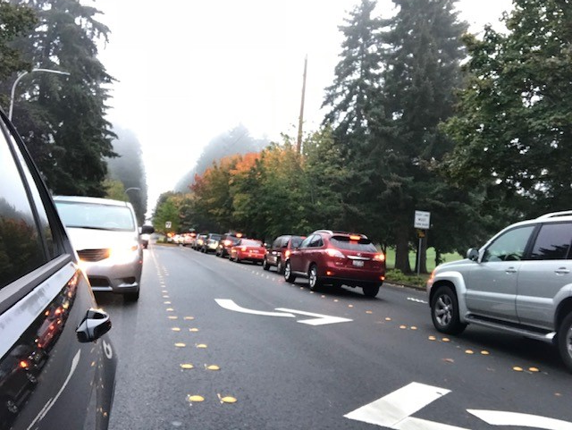
Traffic update
(Kurt Howeler)
We continue to engage with City of Bellevue on traffic issues.
Interlake HS student cars in neighborhood
  Several blocks have gone through the Residential Parking Permit process
  Process must be initiated per block
  https://transportation.bellevuewa.gov/safety-and-maintenance/traffic-safety/residential-parking-management

Slide 26
Block Watch &
Emergency Preparedness

Slide 27
Block Watch
(John Haro)
Suggestions from City of Bellevue Police Liaison for SFCC
Remember to close screen windows during summer when away even for short trip to grocery
Keep lights on at night and during dark time of year – create deterrents
Restrict Access to side and back yards – make it hard to hide – create deterrents
Watch for burglaries during Realtor Open Houses
Package Delivery - use the drop locations for UPS Store, FedEx (Kinkos), Amazon (Safeway Lockers), or schedule delivery time
Talk to strangers without opening door – let them know you are inside
Don’t challenge suspicious persons outside yourself – dangerous
Report suspicious incidents to 911 for BPD crime database analysis – they don’t mind
Its your street : See something – Say something
Keep up what we’ve been doing
https://www.crimemapping.com/map/wa/bellevue

Slide 28
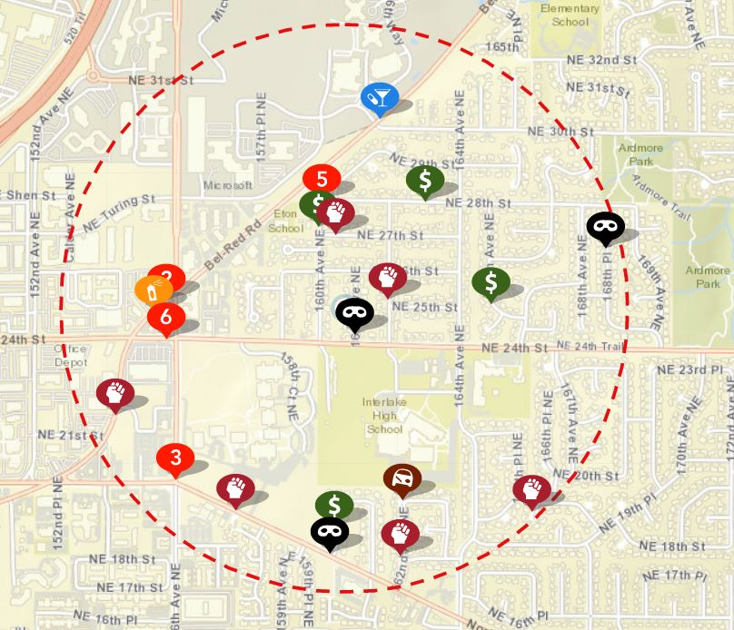
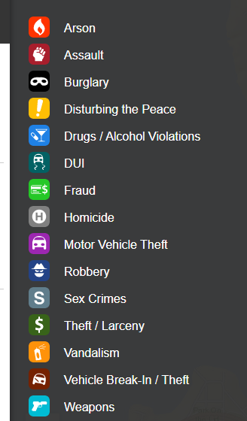
2020 Crime Map for Sherwood Forest ( April 22 – October 21, 2020 )
Crime Map 1/2 Mile SF Radius

Slide 29
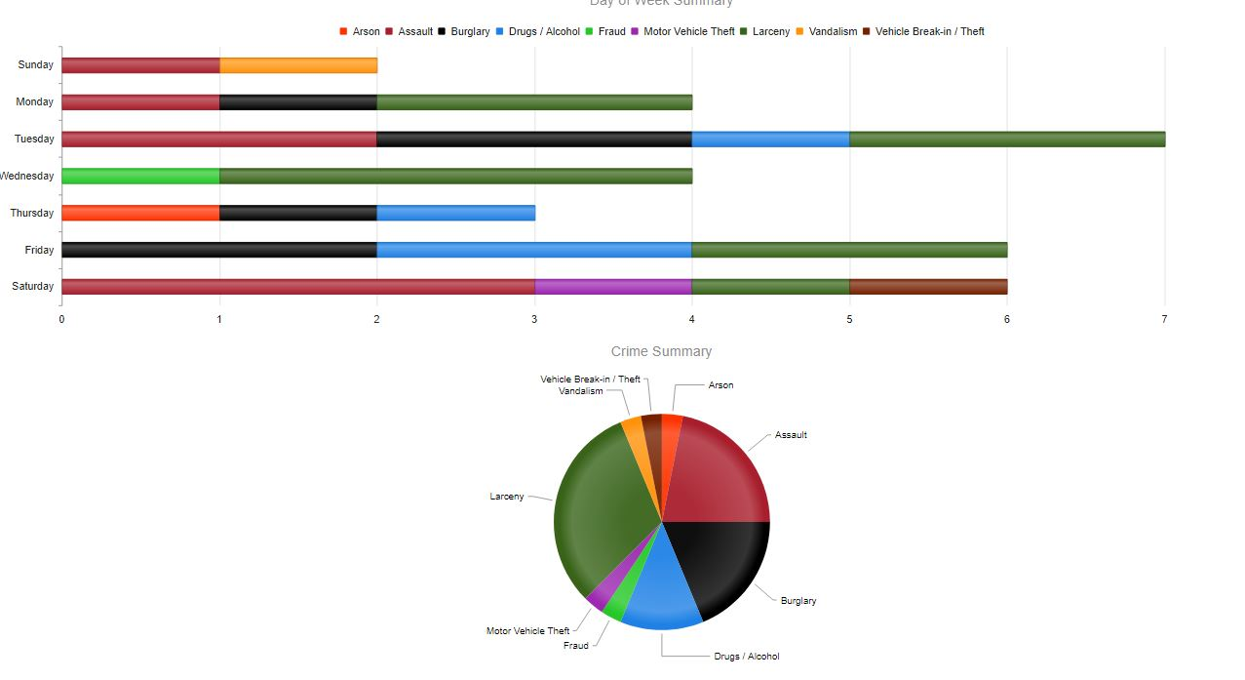
Crime Map
( Day of Week summary )

Slide 30
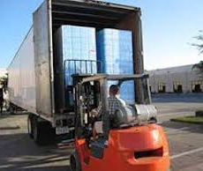

Emergency Preparedness
Lee Sargent is the board representative working on it and currently heading it up. Contact 425-641-7568, LeeSgt@aol.com
THE Focus is to get people involved.
Without a network of people taking small pieces of the work, we can not give adequate effort, connection, response or needed equipment.
With people, we can do some incredible things when needed.
Like get Community Emergency Response Team (CERT) – 8wk/24hr hour class
Like create a network of neighbors with emergency tools, supplies, and/or skills
Volume buy of Water Containers ? $16.20/ea - possibly less if a large order ~ say 100 units = 4 per household for 25 homes – SFCC subsidize 25%?
Volume Purchase for Designated First Aid Kit households around the neighborhood?
Meet with CoB/FireDept to develop a “Getting Your Neighborhood Prepared” plan.
https://www.shakeout.org/washington/

Slide 31
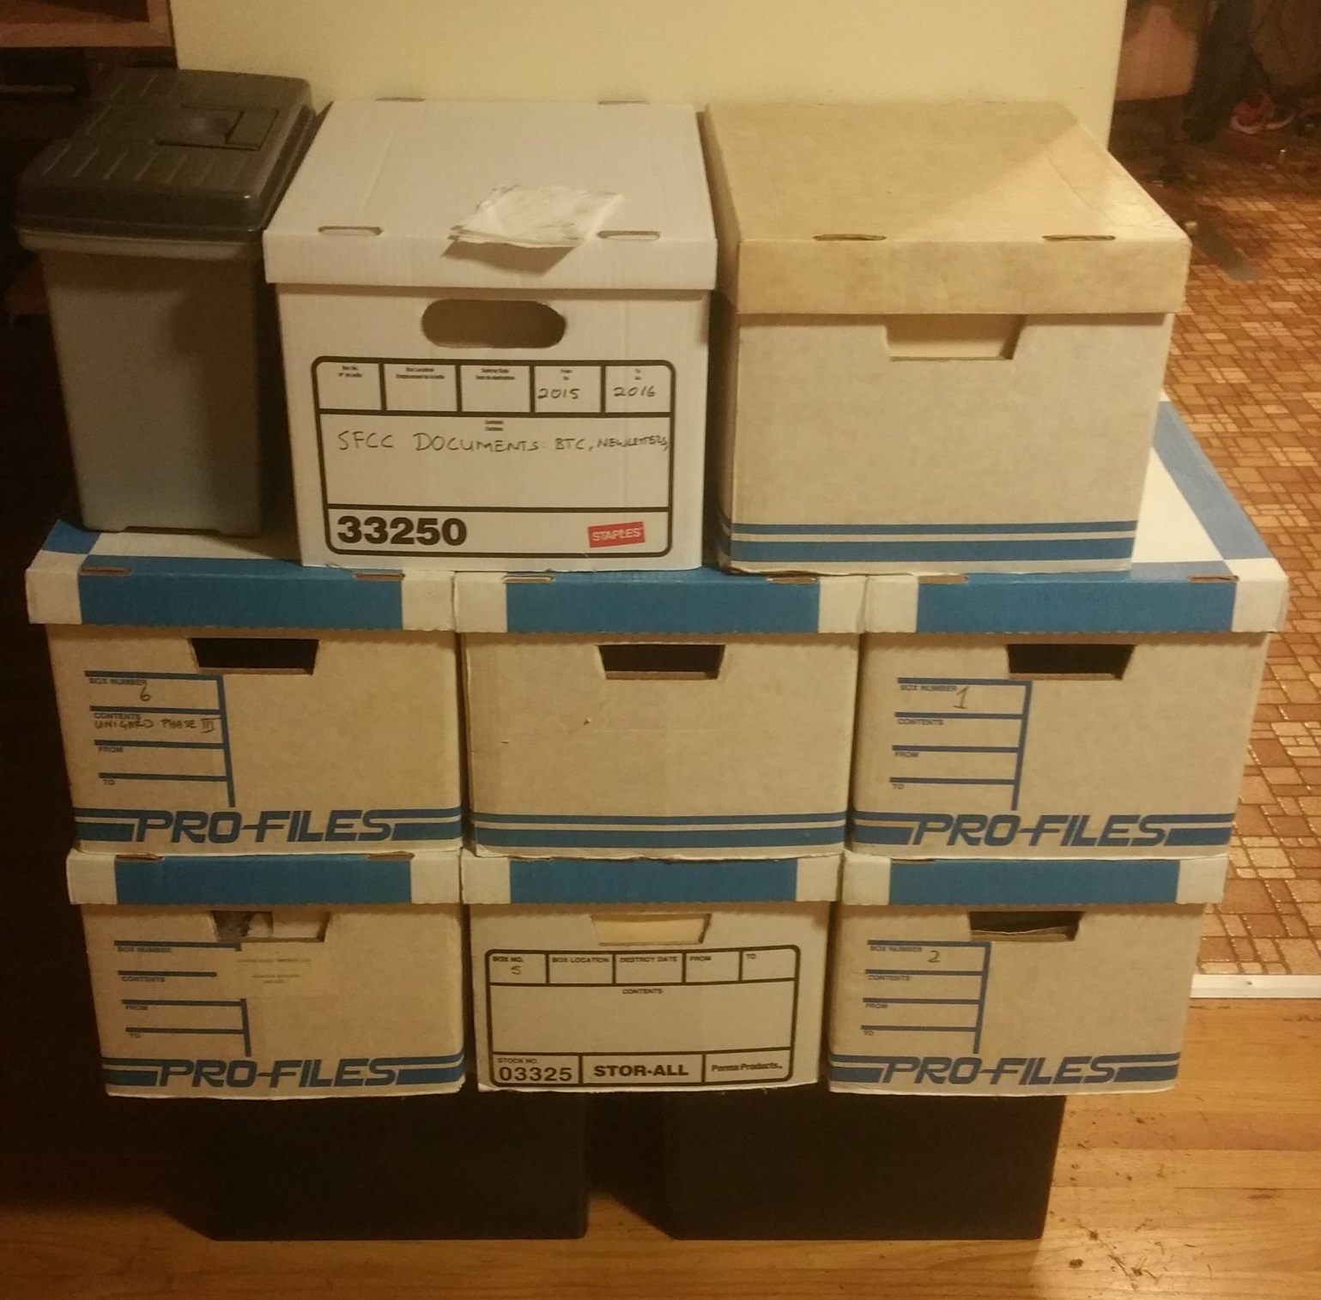
The SFCC Archives
10 boxes of paper = 7 gigs of PDFs
17,767 pages
172 searchable PDFs
Next steps
  What to do with the boxes?
  Where to put the files?

Slide 32


“Engaging Bellevue” and “Great Neighborhoods” programs

Slide 33
https://www.engagingbellevue.com/
https://www.engagingbellevue.com/northeast-bellevue
CoB site with links to active projects that are seeking input from community members and other documents.
  Environmental Stewardship Plan
  Affordable Housing Strategy
  COVID-19 Community Response
The Great Neighborhoods program is the process for developing the vision, opportunities, policies, community goals for NorthEast Bellevue.
Online, virtual, and in-person tools, events, activities.
Input from residents and stakeholders to develop plans that secure our neighborhoods’ future as livable, inspiring, vibrant, and equitable communities
Register to get involved!

Slide 34
Great Neighborhoods - NE Bellevue- Timeline
  Vision Statement (July - Sep, 2020)
    Serves as a north star, guiding policy and action. The foundation for the rest of the plan.
  Neighborhood Profile (Oct. - Nov., 2020)
    Looks at data about who makes up the neighborhood and how people live, work, and play to create a current picture and identify future trends.
  Challenges and Opportunities (Dec - Jan, 2021)
    City staff will work with neighborhood stakeholders to understand and describe key challenges and opportunities.
  Guiding the Conversation (Feb. - Mar., 2021)
    Developing neighborhood-based approaches to addressing challenges and opportunities. This work leads into the creation of policies and a list of priority actions.
  Putting it All Together (April-May, 2021)
    Residents will have the opportunity to see the completed draft and help fine tune it before the Neighborhood Area Plan moves into the legislative process and gets adopted by City Council

Slide 35
SFCC Board Elections

Slide 36
Open positions
SFCC Board:
President: ________
Vice President: ________
Treasurer: ________
Secretary: ________
Trustee: ________ (must be a prior Board member)
Potential Committees:
Block Watch Committee
Communication Committee
Emergency Preparedness Committee
Land Use Committee
Neighborhood Enhancement Committee
Traffic & Transportation Committee

Slide 37
SFCC Committees
(we currently have no committees)
Block Watch Committee
Develop and implement, block-by-block, the City of Bellevue Block Watch program to promote residential awareness, safety, and security.
Involve Block Representatives and other residents in this effort of community safety.
Communication Committee
Develop and maintain an electronic communication system. Help with publication of Quarterly SFCC newsletters and any other community material.
Block Representatives will distribute printed material such as SFCC newsletters etc to residents.
Emergency Preparedness Committee
Develop and implement a block-by-block preparedness program to address impacts from severe storms, earthquakes, and other disasters.
Involve Block Representatives to educate residents on the program.
Land Use Committee
Monitor Bellevue and Redmond land use development proposals affecting the Sherwood Forest neighborhood. Have contact with City of Bellevue officials on Land Use. Be involved with City of Bellevue Land Use events, send summary of event back to SFCC Board.
Neighborhood Enhancement Committee
Monitor the Bellevue Neighborhood Enhancement program, including announcements and proposals for northeast Bellevue from City of Bellevue. Solicit feedback from residents, via Block Representatives, and other means such as social media, email etc., on enhancements to the neighborhood.
Traffic & Transportation Committee
Monitor and report to the SFCC Board of Directors regarding traffic flow patterns and speeds throughout the SFCC neighborhood. Monitor Bellevue and Redmond transportation plans, proposals, and projects with the potential to impact the Sherwood Forest Neighborhood

Slide 38
Discussion/Comments/Q&A
Great Neighborhoods – Brooke Brod and Nicholas Matz?
(Environmental Impact)
(future Traffic issues)
SFCC to set up a committee to revise ByLaws?

Slide 39
Thank You!

Slide 40
Block Watch / Emergency Preparedness Committee
- Sign Up Sheet -
Name Phone Email
Chair: ___ _____ ____________ ________________________
_______________ ____________ ________________________
_______________ ____________ ________________________
_______________ ____________ ________________________
_______________ ____________ ________________________
_______________ ____________ ________________________
_______________ ____________ ________________________
_______________ ____________ ________________________
_______________ ____________ ________________________
_______________ ____________ ________________________

Slide 41
Traffic Committee
- Sign Up Sheet -
Name Phone Email
Chair:____ _____ ____________ ________________________
_______________ ____________ ________________________
_______________ ____________ ________________________
_______________ ____________ ________________________
_______________ ____________ ________________________
_______________ ____________ ________________________
_______________ ____________ ________________________
_______________ ____________ ________________________
_______________ ____________ ________________________
_______________ ____________ ________________________

Slide 42
Neighborhood Enhancement / Communication Committee
- Sign Up Sheet -
Name Phone Email
Chair:__________ ____________ ________________________
_______________ ____________ ________________________
_______________ ____________ ________________________
_______________ ____________ ________________________
_______________ ____________ ________________________
_______________ ____________ ________________________
_______________ ____________ ________________________
_______________ ____________ ________________________
_______________ ____________ ________________________
_______________ ____________ ________________________

Slide 43
Land Use Committee
- Sign Up Sheet -
Name Phone Email
Chair:___ _____ ____________ ________________________
_______________ ____________ ________________________
_______________ ____________ ________________________
_______________ ____________ ________________________
_______________ ____________ ________________________
_______________ ____________ ________________________
_______________ ____________ ________________________
_______________ ____________ ________________________
_______________ ____________ ________________________
_______________ ____________ ________________________

